Slide 1
Korean Merchandise E-Commerce Website
BSIT - BLOCK 3

Slide 2
Introduction
We are pleased to present a proposal solution for your business Unnies Korean Merchandise Shop.
We believe that we can create an E-commerce website that will improve the overall experience for both the Business and Customers.
Base on what you said to us, we have identified and listed the needs and solutions that we will inscribe in this project.

Slide 3
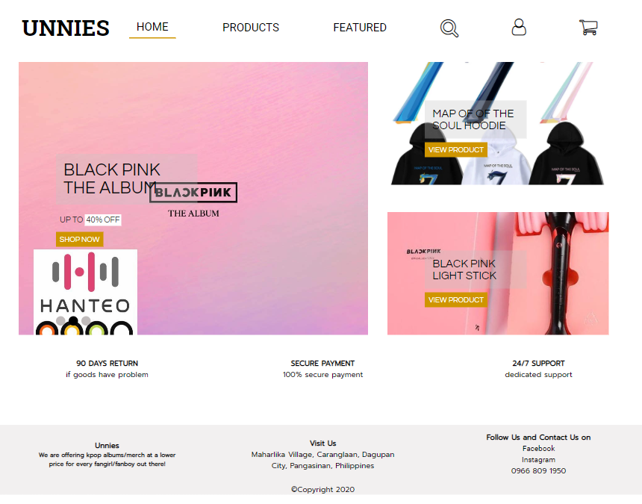
Needs
Unnies Korean Merchandise Shop needs an Ecommerce Website that will help Unnies Korean Merchandise Shop provide better quality of experience in shopping to its customers and elevate the Customers experience in service.
Furthermore Unnies Korean Merchandise Shop needs a website that will be maintained by its Employee without the need to regularly employ the changes in its contents.
Unnies admins and co-admin will be able to revise its content , edit and save changes.

Slide 4
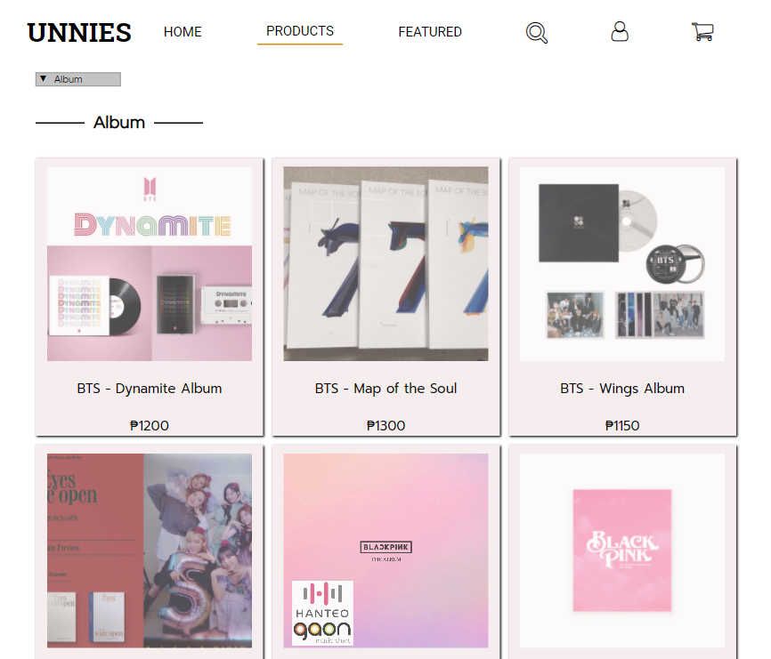
Solutions
Unnies E-commerce website will have a design that is user friendly for the Customers
Unnies E-commerce website design will also convey that the Unnies Korean Merchandise Shop is a professional, reliable, and legitimate online shop.
Unnies E-commerce website will have features of ordering items, featuring products item, and displaying the products.
Unnies E-commerce website will be able to have an admin dashboard the have content management system and simple profit reporting.

Slide 5
Website Organization
Home Page
Authentication Page (both admin and customer)
Registration Page
Products Page
Featured Page
View Product Page
Profile Page
Shopping Cart Page
Check Out Page
These 9 pages will be the foundation of the E-commerce website for Unnies Korean Merchandise Shop.

Slide 6
Preliminary Design
Working with Unnies Korean Merchandise Shop, We will provide Website Wireframe, Website Design Mock Ups, and Concepts. Unnies Korean Merchandise will be able to choose color pallet for the design and request for design revisions.

Slide 7
Training
Unnies E-commerce website will then run a two-hour training session with Unnies Korean merchandise Shop employees, showing them how to use the E-commerce Website, and the Admin System. This can be done on site or online.

Slide 8
Launch
When the Developers are done incorporating and working on all the request, design, and functionalities on the website. They will upload it to the webhost and move it to the main directory of the domain, therefore going live.

